Slide 1
Audio Harmonizer
Urinrinoghene Lauretta Omughelli and Team

Slide 2
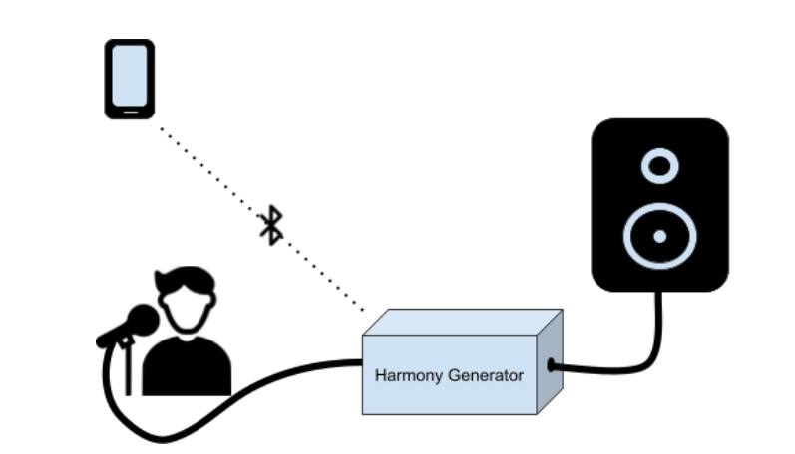
Project Statement
Create a system that allows artists to create multiple harmonies in real time for performances.
Notes:
Jason

Slide 3
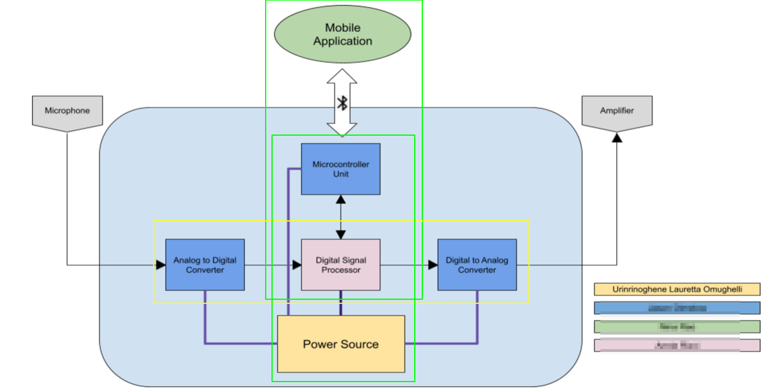
Project Subsystems
Notes:
Nina:

Slide 4
Project Current Timeline
Integrating DSP Algorithms on to Real-Time MCU
MCU and Android Application Bluetooth Communication Complete
Fuel Gauge Integration in Progress
Main PCB Design in Progress
Power Supply PCB Reordered

Slide 5
Subsystem 1: Digital Signal Processor
Accomplishments Since Last Presentation <45 hrs> | Ongoing progress/problems and plans until next presentation
Met with TI Support Refactored project | Complete refactoring Integrate Harmonies Receive user input from MCU

Slide 6
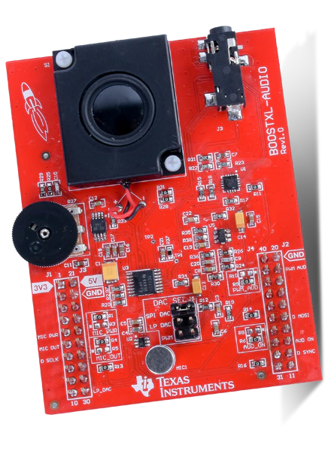
Digital Signal Processor
2 DMA Channels taking Audio input in ping-pong format
Timer set to 20kHz for ADC and DAC input/output
Close to completing continuous audio record and playback
Meeting with TI Support set for tomorrow

Slide 7
Microcontroller Unit
Main Unit Schematic/PCB
Accomplishments Since Last Presentation <5 hrs> | Ongoing progress/problems and plans
MCU Testing from last semester complete Communication with App via bluetooth working fully | Communication with DSP Working on I2C communication with Battery Fuel Gauge
Accomplishments Since Last Presentation <15 Hrs> | Ongoing progress/problems and plans until next presentation
Soldered most of old design PCB | Will be attempting redesign with new MSP430 chip for audio in/out
Notes:
MCU will be relaying data to and fro the dsp/user interface via bluetooth. Telling the DSP what type of harmony the user wants, and then sending the digital to back to the app...

Slide 8
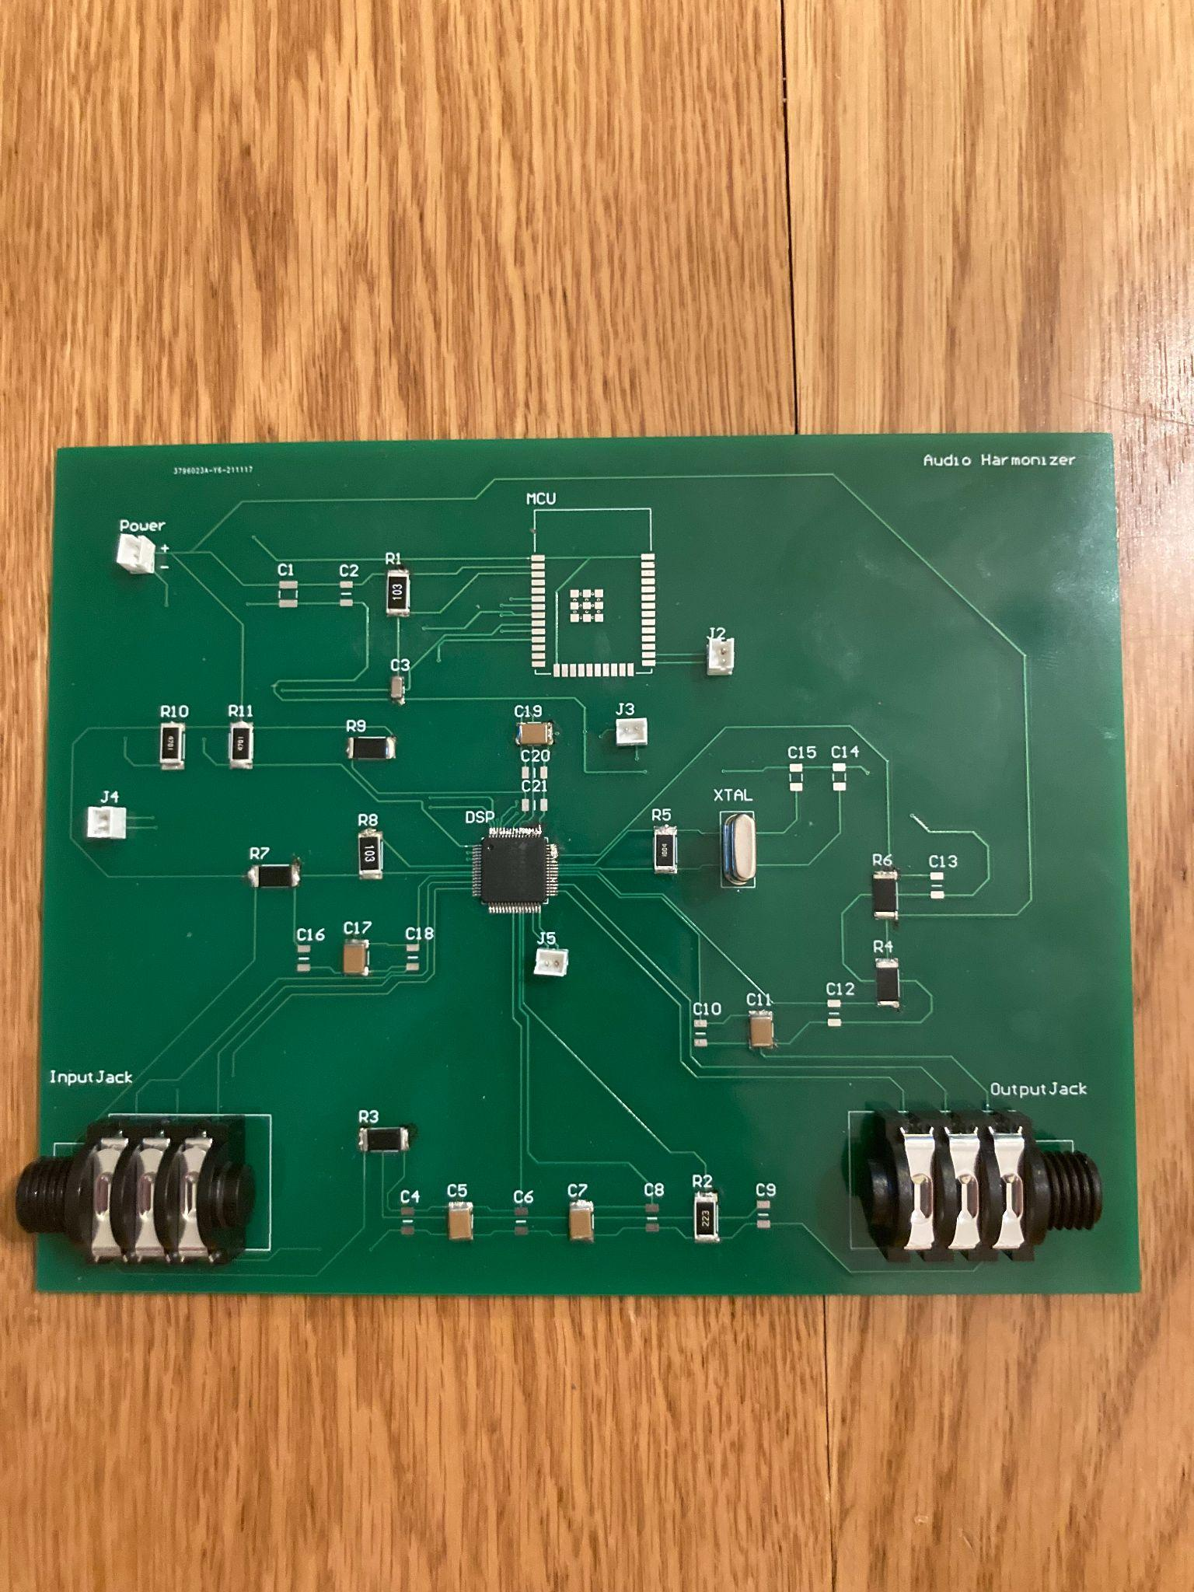
PCB Design
Need to add missing capacitors
Likely will redesign with MSP430

Slide 9
Power Supply and Integration with MCU I2C Communication
Accomplishments Since Our Last Presentation <10 hrs> | Ongoing progress/problems and plans until next presentation
Tested PCB functionality Fuel gauge I2C programming for Integrating with MCU subsystem | PCB short circuit issue due to clearance rule violation being diabled in Altium Issue resolved and PCB reordered Test I2C communication with ESP 32

Slide 10
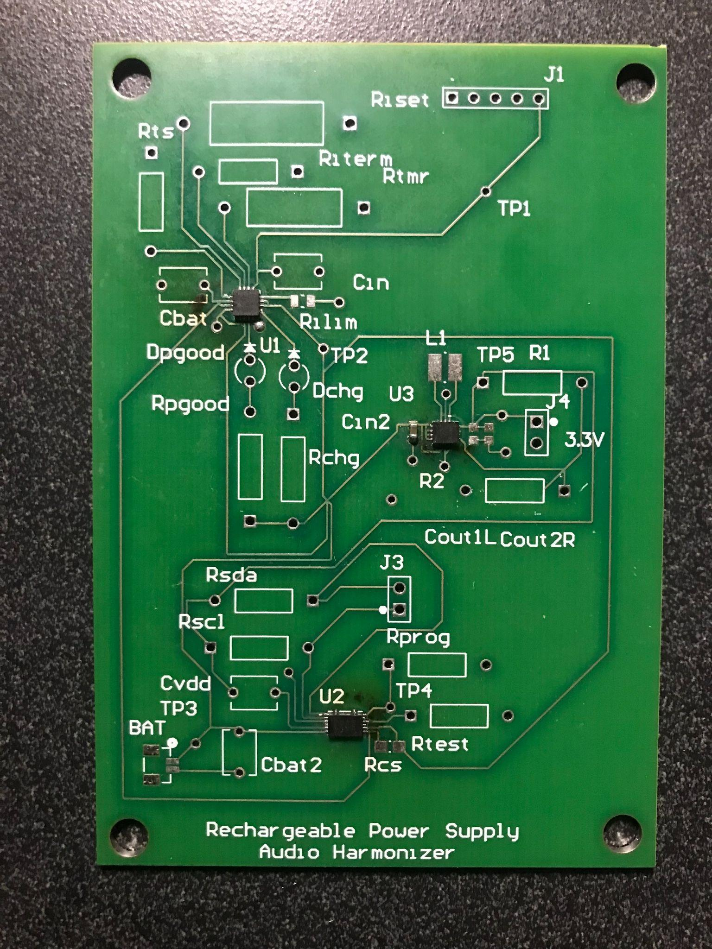
Power Supply PCB

Slide 11
Fuel Gauge Reading
Lauretta & Annie
Arduino Library for BQ27411
Should work with BQ27441
Arduino Code written to read I2C data for:
State of charge
Voltage
Current
Re-test once parts are completely soldered

Slide 12
Bluetooth Communication
Jason & Nina
MCU and Android App Connect via Bluetooth
Android App able to send user inputs as string
MCU Arduino Code able to receive and interpret user input into corresponding variables for manual and automatic modes
Android App is able to receive battery level from the MCU and display it accordingly

Slide 13
Parts Ordering Status
Main PCB needs to be ordered

Slide 14
Progress

Slide 15
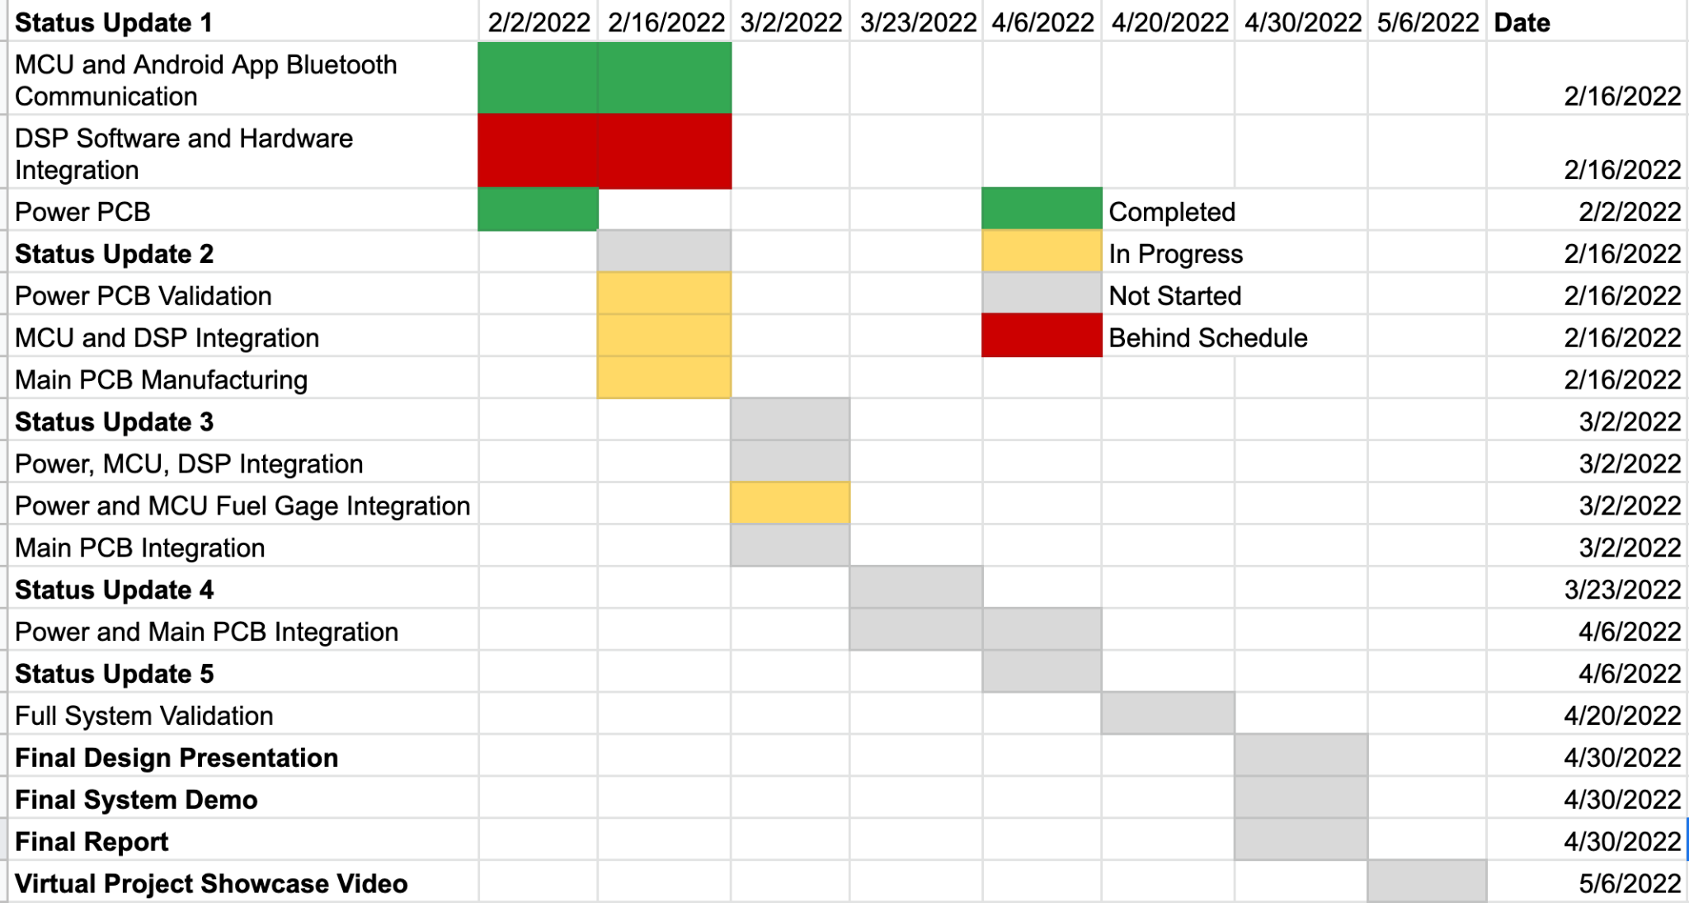
Execution Plan

Slide 16
Questions?

